Slide 1
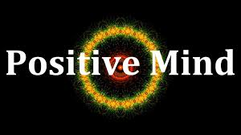
Unanswered questions…?
Manas K Mandal

Slide 2
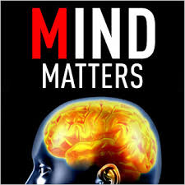
Why do we fail to understand positivity?
Our fascination with negative behavior
Neglect of the environment and of the positive
The lack of developmental emphasis
Difficulties understanding behavior in a cultural context
The limits of understanding others

Slide 3

Mind: The Misconceptions
People with positive state of mind have better awareness about self
Intelligent people have better mind
Persons with spiritual state of mind do not have anxiety or stress
Physically fit persons attain higher levels of consciousness
Presence of positive thoughts ensures absence of negative ideas

Slide 4
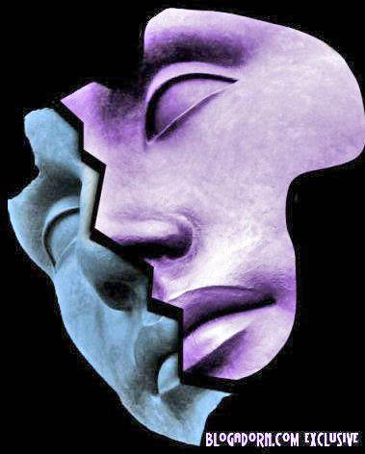
Mental Heath: The Misconceptions
Mental health refers about negative state only
Only a few people suffer from negative mental health
Persons with positive mental health do not suffer from anxiety or stress
Physically fit persons suffer less from mental health problem
Improved mood rules out depression

Slide 5
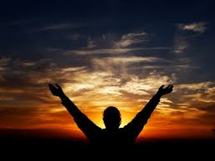
Belief: A state in which someone holds a premise to be true
How far faith & health related?
Does spirituality predict better disease control?
In there a biological mechanism that regulate belief?
Is belief an alternative to medicine?
Do we have a specific brain region that gets activated during prayer or meditation?
Kluger, 2009: TIME

Slide 6
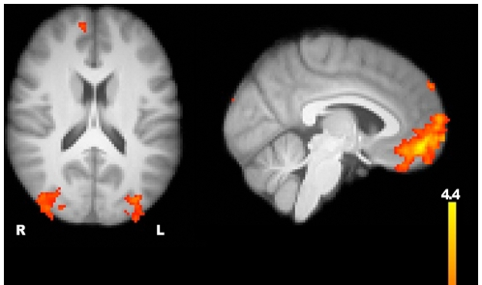
Belief: The brain centers
Greater signal for belief compared with disbelief appeared in ventromedial prefrontal cortex, lateral occipital cortex, & superior frontal gyrus
Harris et al. (2009)

Slide 7
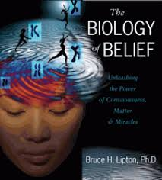
Faith: Strong belief in the doctrine of religion, based on spiritual conviction rather than proof
Can prayer heal our pain or bring us peace?
Is fasting a wellness protocol or traditional ritual?
Does long-term meditation change our brain?
Can scientific exactitude dissuade believers?
Can science & religion join hands to heal pain (The Templeton Foundation)?
The biology of belief: Bruce Lipton

Slide 8
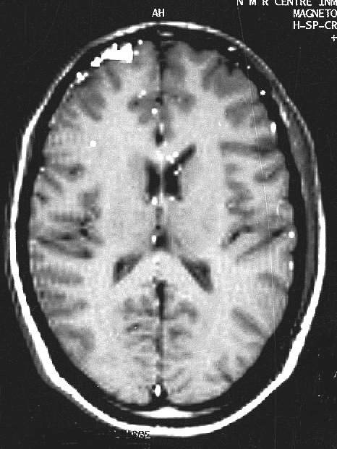
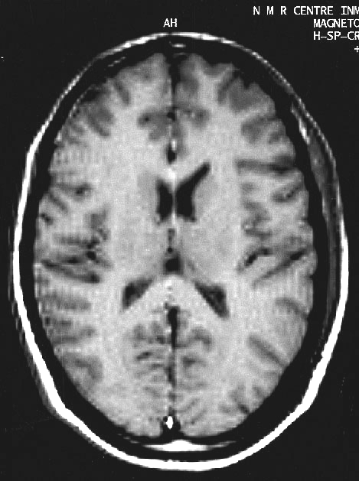
fMRI during Meditation: 2-5 years
During Meditation During Non-meditation

Slide 9
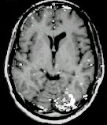
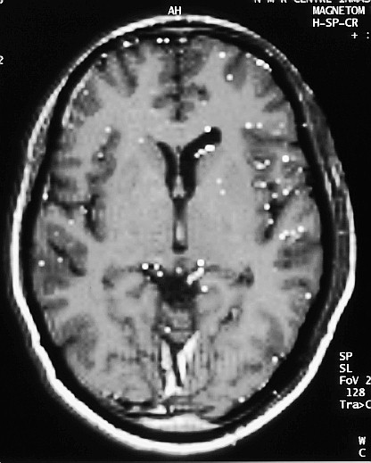
fMRI during Meditation
> 17 Years
During Meditation During Non-meditation
Khushu et al., 2004
Khushu et al. 2007

Slide 10
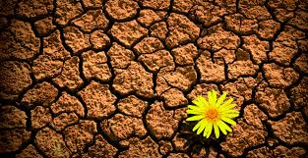
Resilience: Attainment of competence despite adversity
Why some people bounce back while others collapse after failure?
Is the basis biological, psychological or social-contextual?
Is it possible to find out the pathways that evantuate to resilience?
Can we train people to become resilient or mentally tough?

Slide 11
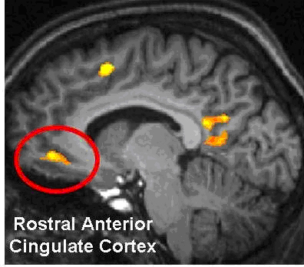
Resilience: The brain centers

Slide 12
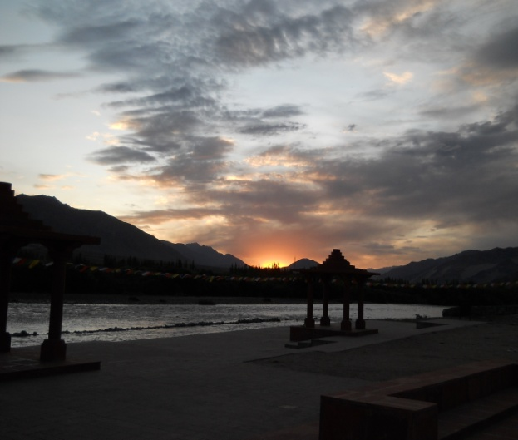
Optimism: An expectancy that good, rather than bad, will prevail
Are we naturally positive?
Is optimism a biologically defined state?
Can we produce bio-chemical change in our body by becoming optimistic?
Do optimists live longer than pessimists?
Why some people get benefit from ‘placebo’ while others develop ‘nocebo’ effect ?

Slide 13
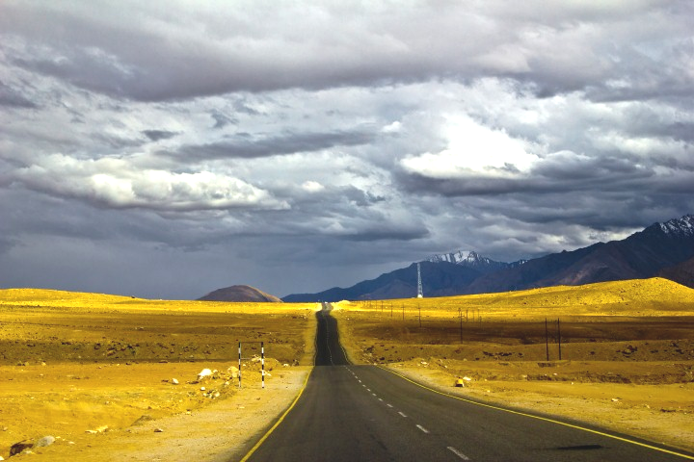
Optimism bias: An expectancy that good, …, will occur, without evidence to support
Do we expect to live longer & be healthier than average?
Do we overestimate the prospect of success everytime?
Do we make more mistakes by becoming unrealistically optimistic?
Do we have selective estimation error about future?

Slide 14
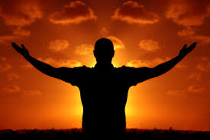
Important Considerations
Realize potential first…limits later
Take personal risk first…seek from others later
Judge first in crisis…rely on data later
Change attitude of others…look for aptitude later
Invite challenge… ensure predictability later
Remain imperceptible…become a ‘guru’ later
Embrace ‘right’ decision… ‘best’ decision later

Slide 15
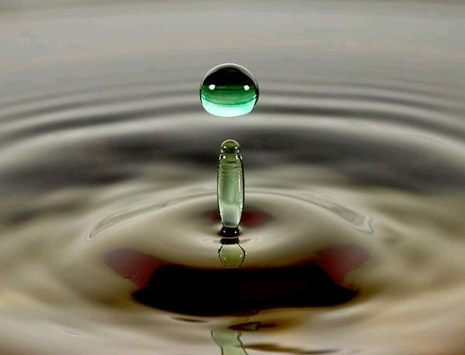
Thanks for being positive…

